Slide 1
Brain Tumor Detection System
#1 View of Progress as of 2/4/2024
Abdullah Alshamrani
Saint Joseph’s University

Slide 2
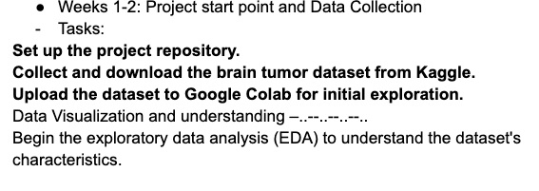

Slide 3
What I have done:
I Set up the project repository.
Collected and downloaded the brain tumor dataset from Kaggle
Uploaded the dataset to Google Collab for initial exploration
Data Visualization and understanding is still under the process

Slide 4
What I have done:
I Set up the project repository: https://github.com/Abdullah-Alshamrani/Brain-Tumor-Detection-System
Collected and downloaded the brain tumor dataset from Kaggle
Uploaded the dataset to Google Collab for initial exploration
Data Visualization and understanding is still under the process

Slide 5
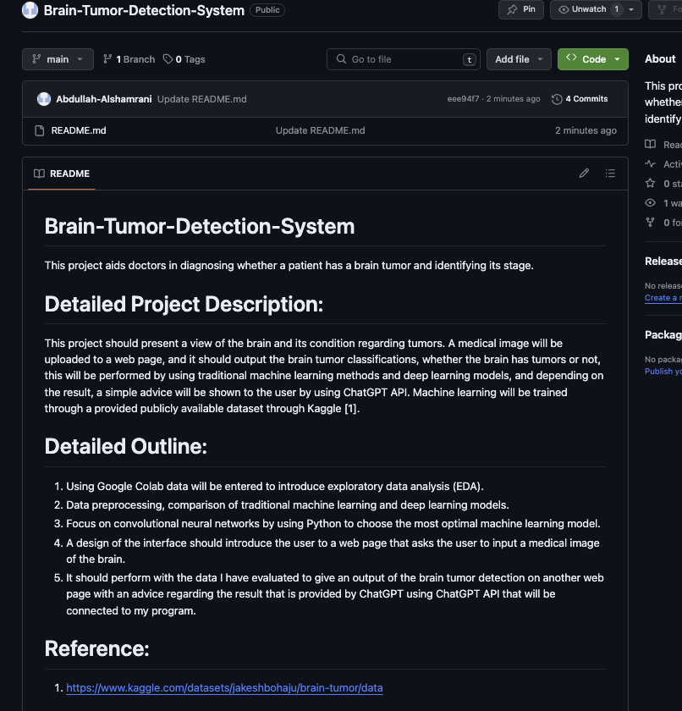

Slide 6
What I have done:
I Set up the project repository: https://github.com/Abdullah-Alshamrani/Brain-Tumor-Detection-System
Collected and downloaded the brain tumor dataset from Kaggle
Uploaded the dataset to Google Collab for initial exploration
Data Visualization and understanding is still under the process

Slide 7
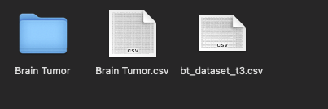
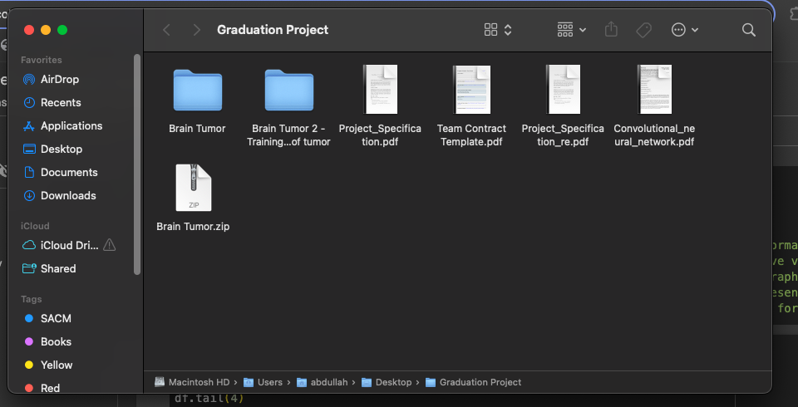
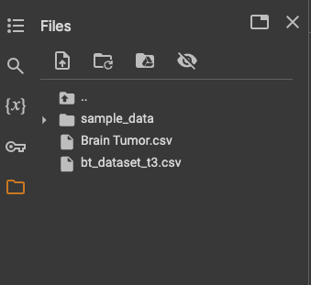
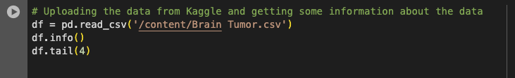
^^ In Google Colab
^^ Actual code in Python to download the dataset

Slide 8
What I have done:
I Set up the project repository: https://github.com/Abdullah-Alshamrani/Brain-Tumor-Detection-System
Collected and downloaded the brain tumor dataset from Kaggle
Uploaded the dataset to Google Collab for initial exploration
Data Visualization and understanding is still under the process

Slide 9
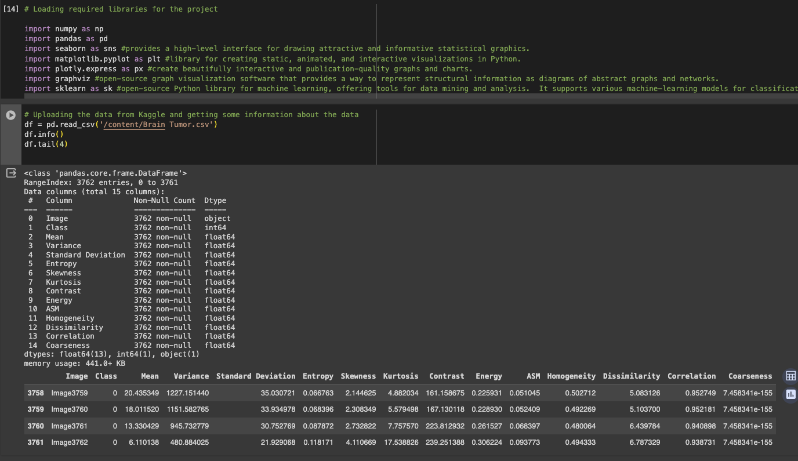
Required Libraries
← Actual code in Python to download the dataset
Initial exploration for the dataset preformed

Slide 10
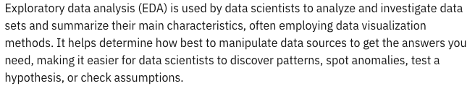
Under the process to be completed by 2/12/2024
Data Visualization and understanding
Exploratory data analysis (EDA) to understand the dataset's characteristics.

Slide 11
Reference
"Exploratory Data Analysis." IBM, n.d., https://www.ibm.com/topics/exploratory-data-analysis.

